Slide 1
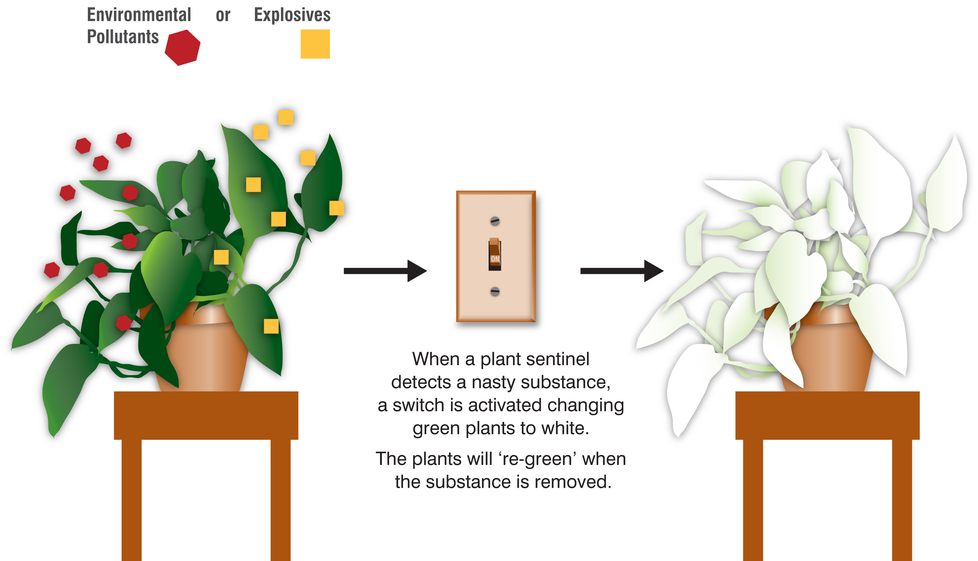
Engineered plants detect explosives, air pollution and toxic chemicals
SOURCE: “Re-engineered plants may root out terrorism threats”, Denver Post, 1/27/11.
Notes:
February 17, 2011

Slide 2
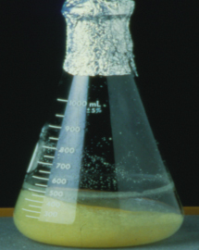
For first time, FDA approved a drug for Gaucher disease produced in a GE plant
SOURCE: “First plant-made drug on the market”, Nature News Blog, 5/2/12
Notes:
May 4, 2012

